Slide 1
Rheumatoid arthritis
Dr.S.A.F.Kurukulasuriya

Slide 2
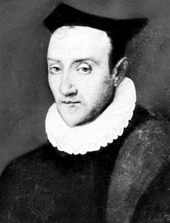
Guillaume de Baillou (1538-1616)

Slide 3
Guillaume de Baillou
1591
“The whole body hurts, in some the face is flushed. Pain is most severe around the joints. So the slightest movement of the foot, hand or finger causes a cry of pain. At night the pain becomes severe and the patient can not sleep”

Slide 4
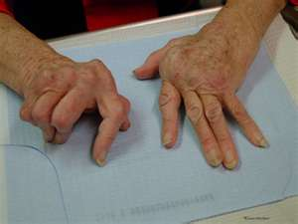
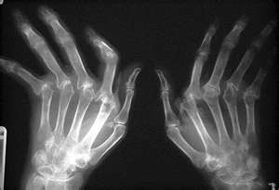
Epidemiology
Chronic, inflammatory disorder
Multi system disease
Destructive synovitis
Prevalence 0.5-1 % in the general population 2% among patients over 60 yrs
^{YORA/EORA}

Slide 5
Female : Male = 3 : 1
Age of onset is between 40 -50 years
More common in smokers
Prevalence rate 2-3% in first-degree relatives.
Incidence 3 / 10,000 population
Strongly associated with HLA-DR 1 and HLA-DR4

Slide 6
Signs and symptoms
It can be difficult to determine whether disease manifestations are directly due to the rheumatoid process or due to side effects of drugs.
Articular
Extra-articular

Slide 7
Signs and symptoms-Joints
Synovitis-Joints are swollen,tender and warm.
Stiffness of the joints,mane/after rest.
Usually a bilateral,symmetrical polyarthritis affecting the hand joints (esp.MCP and PIP joints),feet and the cervical spine.
Large joints-shoulders,knees can be involved.

Slide 8
Signs and symptoms-Joints
Inflammatory activity leads to tendon tethering ,erosion and destruction of the joints.
Depending on the joints that are mostly involved-ulnar deviation,boutonnieres deformity,swan neck deformity,Z-thumb

Slide 9
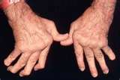


Signs and symptoms

Slide 10



Slide 11
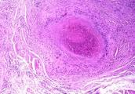
Signs and symptoms-skin
Rheumatoid nodule-often subcutaneous
Over bony prominences-olecranon,calcaneal tuberosity,MP joint.
The nodule has a central area of fibrinoid necrosis with a layer of surronding layer of palisading macrophages and fibroblasts. Cuff of connective tissue with lymphocytes and plasma cells.

Slide 12
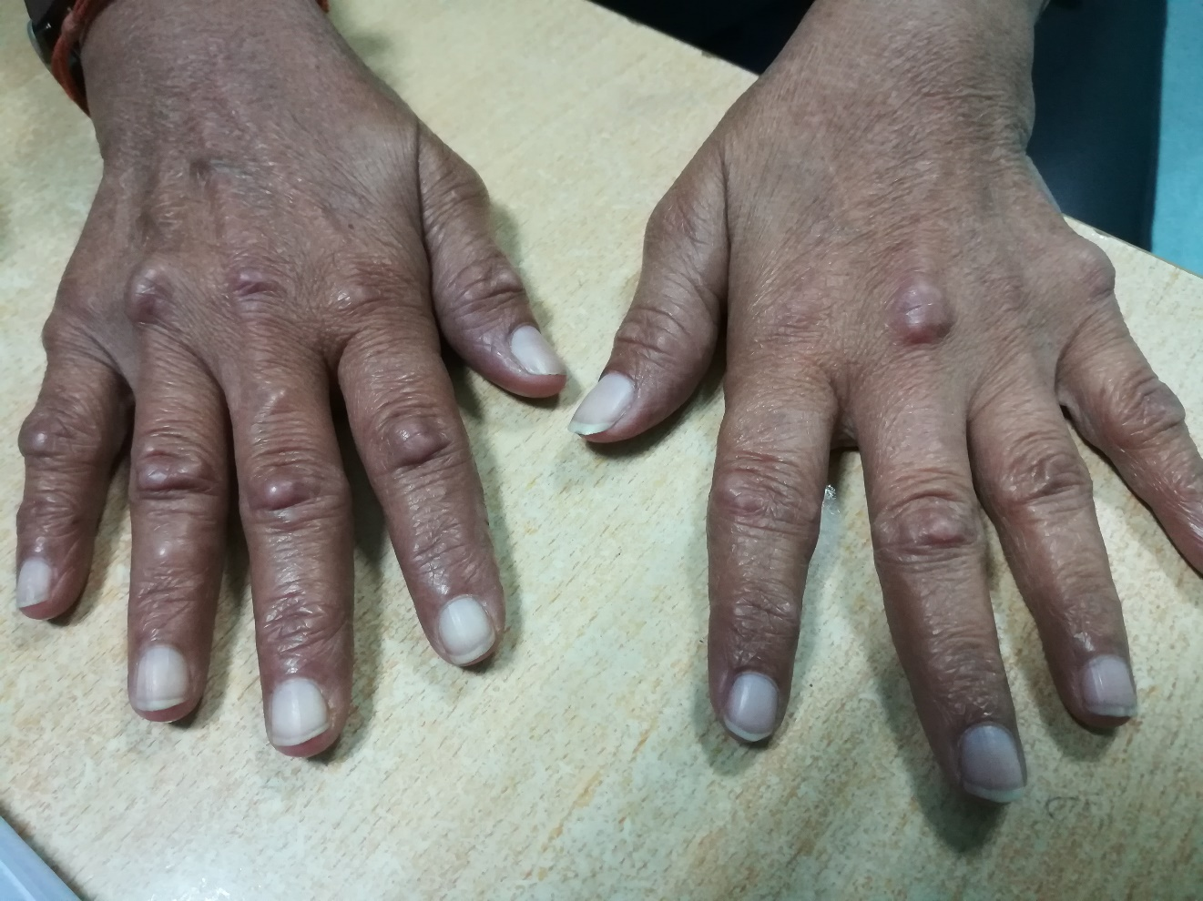

Slide 13
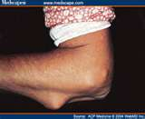
Associated with positive rheumatoid factor and severe erosive arthritis.
Can occur in internal organs

Slide 14
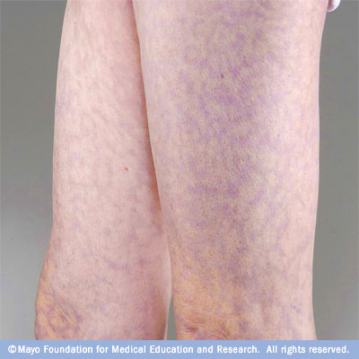
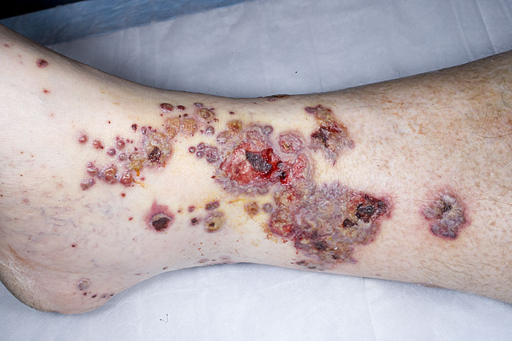
Signs and symptoms-Skin
Vasculitis-Several forms
Microinfarcts around nail folds(benign)→livido reticularis.

Slide 15
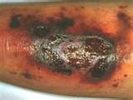
Pyoderma gangrenosum- necrotizing ,non-infectious ulcerative, neutrophilic dermatosis.
Sweet’s syndrome-usually ass.with myeloproliferative disorders.
Erythema nodosum.
Palmar erythema.
Diffuse thinning .

Slide 16
Lungs
Fibrosis of lungs-
Due to disease
Drugs -Methotreate and leflunamide
Pleural effusions
Caplan’s syndrome

Slide 17
Kidneys
Renal amyloidosis-due to chronic inflammation.
Membranous nephropathy- Penicillamine, gold salts

Slide 18
Heart and blood vessels
More prone to atherosclerosis
Risk of MI and CVA increased-LDL targets reduced
Pericarditis,endocarditis,valvulitis
Left ventricular faliure

Slide 19
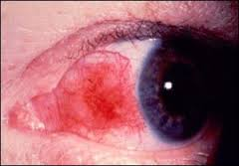
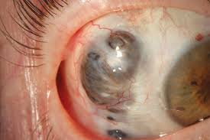
Ocular
Episcleritis
Scleromalacia perforans
Dry eyes-lymphocyte infiltration of the lacrymal ducts.

Slide 20
Liver
Increased production of acute phase proteins-CRP
Increased release of enzymes such as alkaline phosphatase to blood
Nodular hyperplasia of the liver-ass.with Felty’s syndrome.

Slide 21
Haematological
Anaemia-
Iron deficiency type
Normocromic normocytic
Megaloblastic
Felty’s syndrome
AIHA
Neutropenia
Thrombocytosis

Slide 22
Constitutional symptoms
Fatigue
Low grade fever
Malaise
Morning stiffness
LOA
LOW

Slide 23
Osteoporosis
Local-around inflammed joints.
General osteoporosis-
Immobility
Systemic cytokine effects
Corticosteroid therapy

Slide 24
Diagnosis
Blood tests-Initial
ESR,CRP
FBC
Renal functions
Liver functions
Ferritin levels
Chest X-ray PA view

Slide 25
Diagnosis contd…
Rheumatoid factor-15% sero negative.May convert later on.
Seen in 10% of the normal population.
ACPA (Anti-citrullinated protein antibodies)- 95% specific
Most common-Anti-CCP antibodies(Cyclic citrullinated peptides)

Slide 26
X-rays
Hands and the feet
May be no changes-early disease
Soft tissue swelling
Juxta articular osteopenia
Loss of joint space
Erosions and sublxations

Slide 27
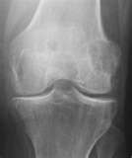
II ry RA

Slide 28
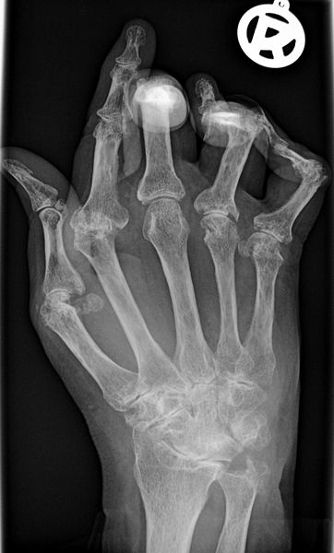

Slide 29
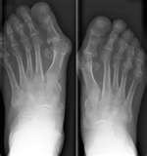

Slide 30
Diagnostic criteria
At least 4 of
Morning stiffness of more than 1 hour for at least 6 weeks
Arthritis of more than 3 joint areas for at least 6 weeks
Arthritis of hand joints for at least 6 weeks
Symmetrical arthritis
Rheumatoid nodules
Rheumatoid factor
Joint erosions

Slide 31
Treatment
No known cure
Aim-alleviate symptoms,Prevent further destruction
Patient education
Medication
Monitoring disease activity and drug treatment
Physiotherapy/Occupational therapy
Psychological support

